Slide 1
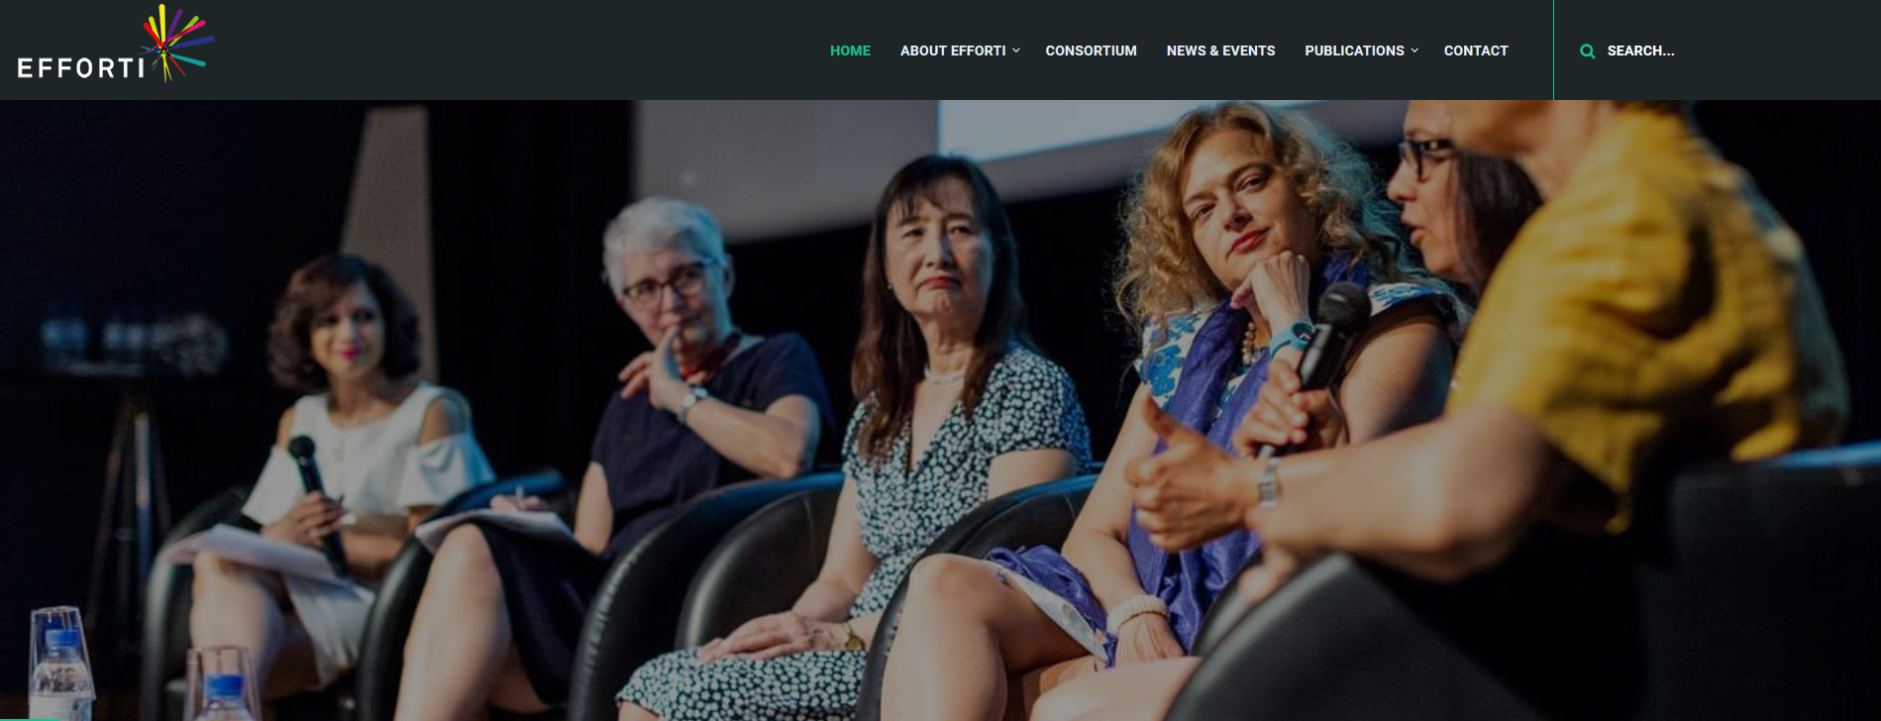

Evaluation Framework for Promoting Gender Equality in Research and Innovation
Teil II Praktische Anwendung
Netzwerktreffen TOTAL EQUALITY Deutschland e.V., 4. November 2019, München
Susanne Bührer, Merve Yorulmaz

Slide 2


WHY
„Unser Unternehmen möchte diverser werden, wir haben eine Menge Pläne, aber wir wissen nicht genau, wie wir unser Wissen und unsere Aktivitäten besser systematisieren können.“
„Diversity ist wenig greifbar, das Thema wird nicht so ernst genommen... Wie schaffe ich es, dieses vage Konzept so zu fassen, dass es mit messbaren Kenngrößen versehen ist?“
„Ich möchte das Thema Diversität und Inklusion vorantreiben - mir fehlen aber geeignete Instrumente.“
„Ich möchte mich bei der Wahl von geeigneten Gleichstellungsmaßnahmen inspirieren lassen.“
„Ich brauche Unterstützung, um gegenüber meinen Vorgesetzen überzeugende Argumente für die Einführung von Gleichstellungs-maßnahmen vorbringen zu können.“
Notes:
RISK OF WRONG DIVERSIFICATION – NUMBER‘S GAME
DIFFERENTIATED AND PRUDENT HANDLING – AWARENESS OF CONTEXT DYNAMICS
CHALLENGES FOR RERUITING: NO UNIVERSAL STRATEGY

Slide 3
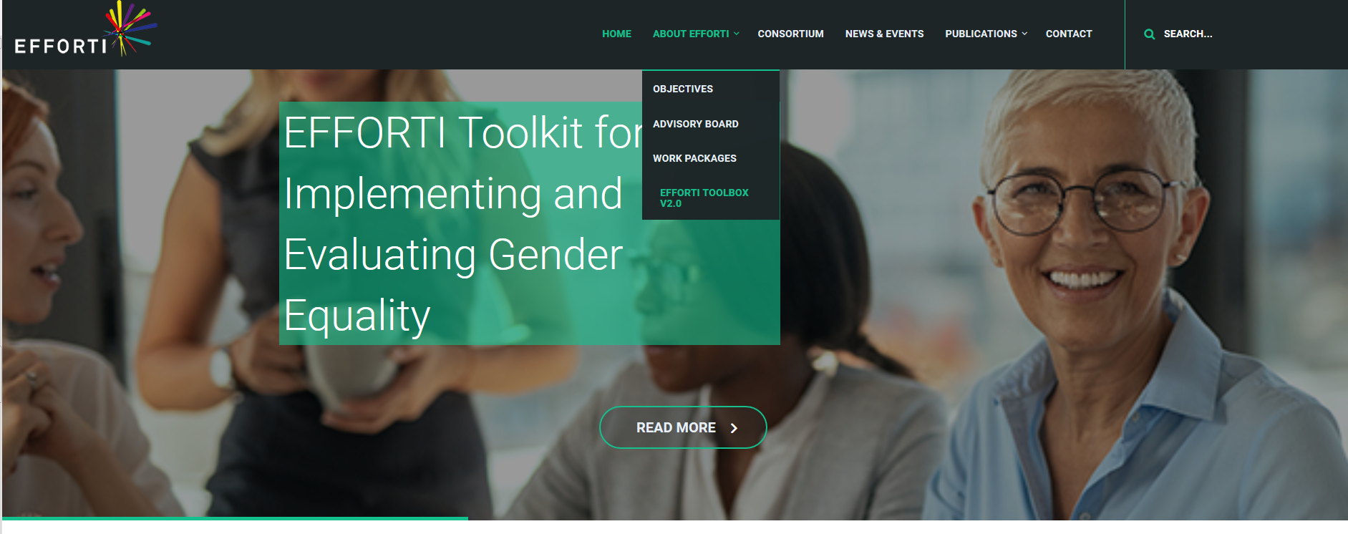

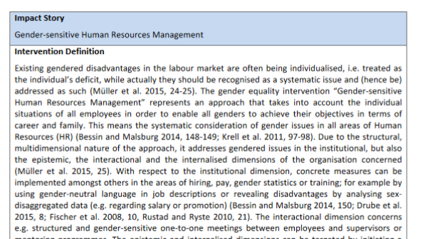
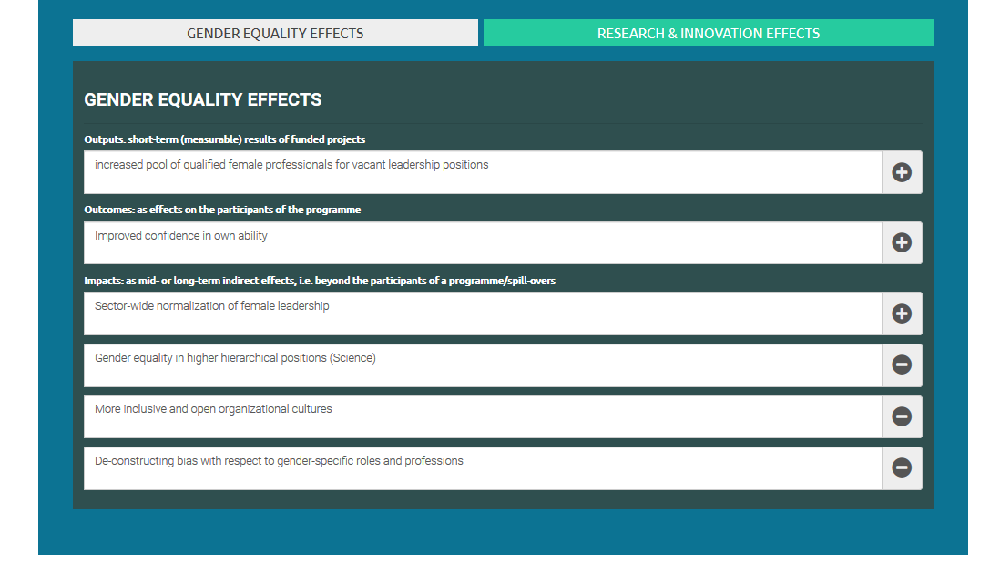
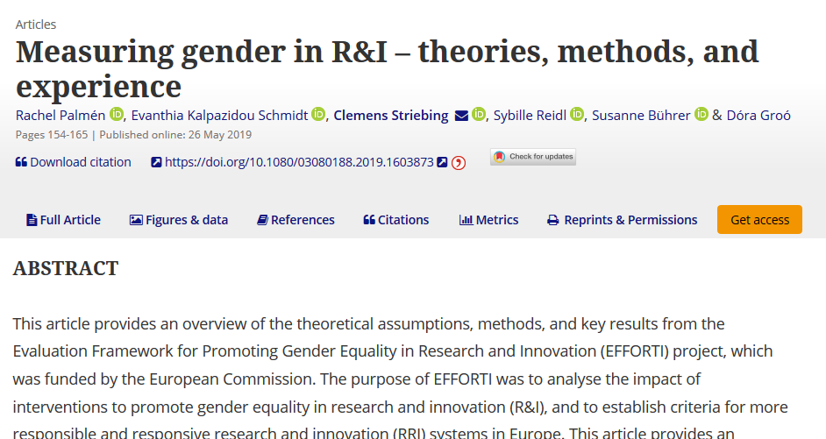
WHAT
Notes:
RISK OF WRONG DIVERSIFICATION – NUMBER‘S GAME
DIFFERENTIATED AND PRUDENT HANDLING – AWARENESS OF CONTEXT DYNAMICS
CHALLENGES FOR RERUITING: NO UNIVERSAL STRATEGY

Slide 4
WHAT
EFFORTI bietet Ihnen ein ausgeklügeltes, ganzheitliches und umfassendes Instrument, mit dem Sie analysieren können, wie Gleichstellungsmaßnahmen zur Erreichung zentraler Ziele beitragen, wie z.B. mehr Frauen in Forschung und Entwicklung oder mehr Frauen in Führungspositionen.
Die Toolbox dient nicht der Bewertung oder Beurteilung einer Maßnahme
der Messung der Effektivität oder Effizienz einer Maßnahme
Die Toolbox ist kein selbständig arbeitender Algorithmus, sie lebt von den Eingaben der Nutzer/-innen Benchmarking-Instrument
BEACHTE: Jede Evaluation ist ein einzigartiger Prozess Wirkungen hängen stark vom jeweiligen Kontext ab

Slide 5

WHO
Ministerien
Diversity Beauftragte
Forschende
Programm-Designer
Personal-verantwortliche
...
Fördergeber / Stiftungen
Notes:
RISK OF WRONG DIVERSIFICATION – NUMBER‘S GAME
DIFFERENTIATED AND PRUDENT HANDLING – AWARENESS OF CONTEXT DYNAMICS
CHALLENGES FOR RERUITING: NO UNIVERSAL STRATEGY

Slide 6
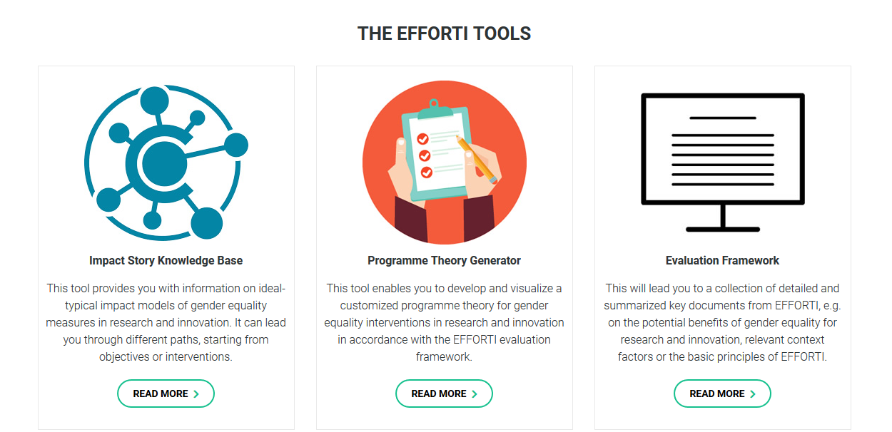
HOW
Impact Story
Knowledge Base
Shows impact pathways
Inspiration
Programme Theory Generator
Create and visualize own program theory with EFFORTI template
Creation
Evaluation
framework
Document & report database
Reading & literature
Notes:
RISK OF WRONG DIVERSIFICATION – NUMBER‘S GAME
DIFFERENTIATED AND PRUDENT HANDLING – AWARENESS OF CONTEXT DYNAMICS
CHALLENGES FOR RERUITING: NO UNIVERSAL STRATEGY

Slide 7
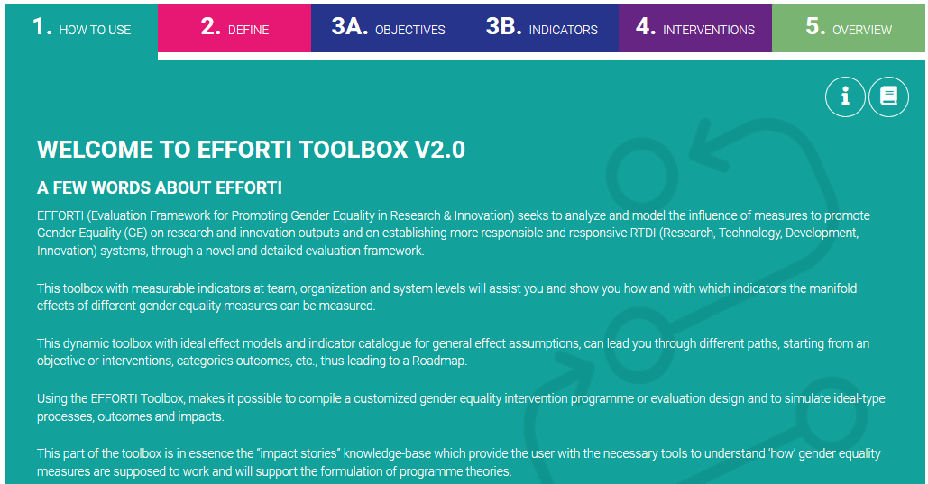
HOW
Notes:
RISK OF WRONG DIVERSIFICATION – NUMBER‘S GAME
DIFFERENTIATED AND PRUDENT HANDLING – AWARENESS OF CONTEXT DYNAMICS
CHALLENGES FOR RERUITING: NO UNIVERSAL STRATEGY

Slide 8
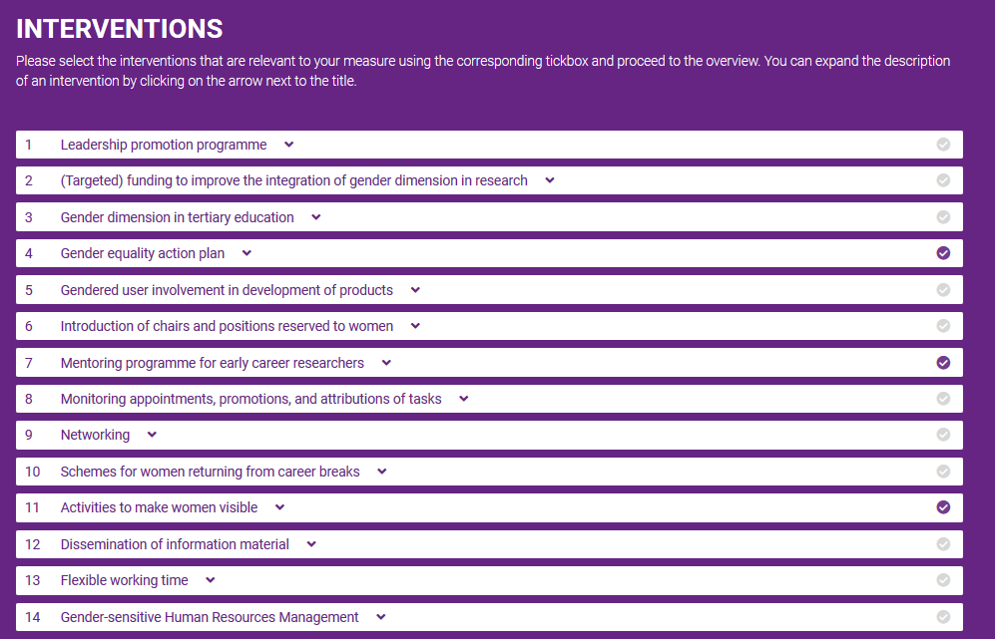
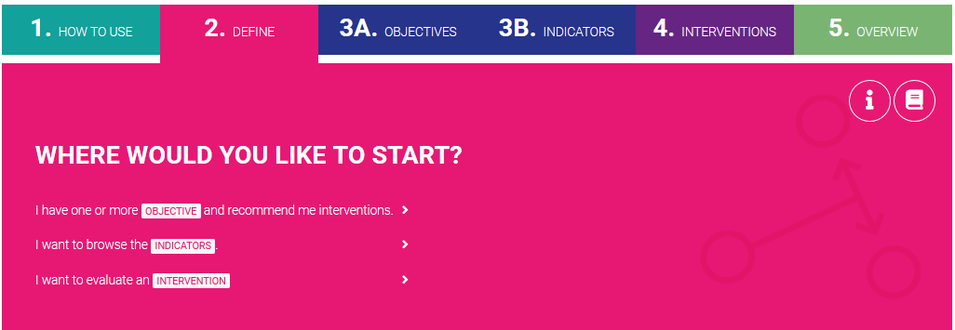
HOW
examples: improve working conditions/work-life balance /
increase number of women in R&I positions
example: transparent promotion system
example: mentoring programme for early career researchers

Slide 9
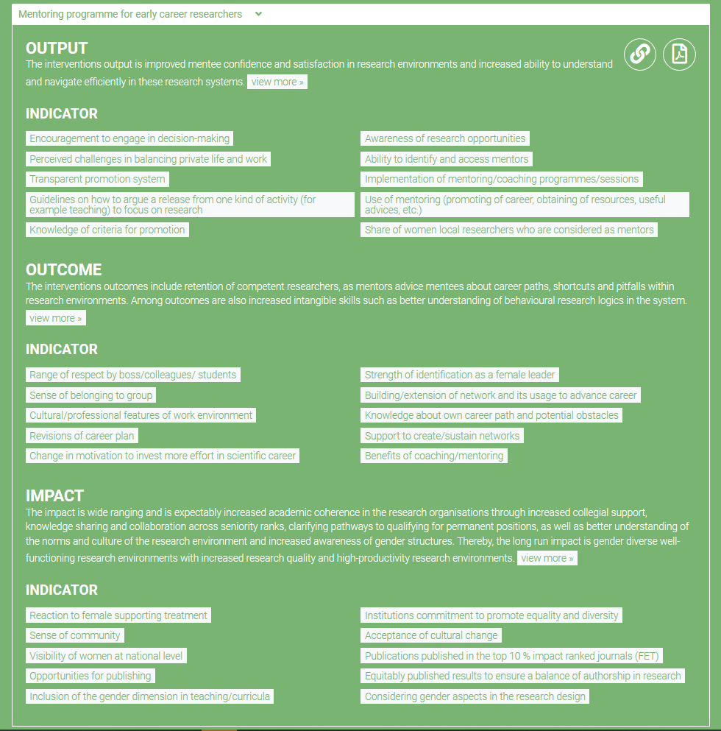
t
Intervention >
Output >
Impact Story Knowledge Base
Network: Interventions & indicators
Outcome >
Impact >
t
Impact Story Overview

Slide 10
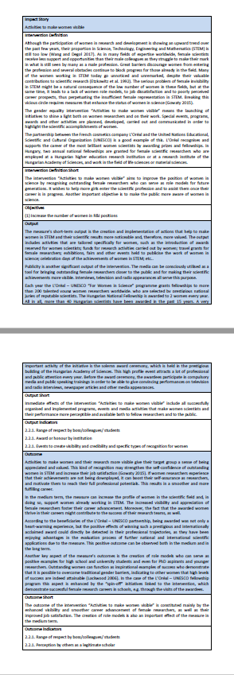
HOW
Own customized impact story:
How my intervention(s) would cause which effects

Slide 11
HOW
Impact Story
Knowledge Base
Shows impact pathways
Inspiration
Programme Theory Generator
Create and visualize own program theory with EFFORTI template
Creation
Evaluation
framework
Document & report database
Reading & literature
Notes:
RISK OF WRONG DIVERSIFICATION – NUMBER‘S GAME
DIFFERENTIATED AND PRUDENT HANDLING – AWARENESS OF CONTEXT DYNAMICS
CHALLENGES FOR RERUITING: NO UNIVERSAL STRATEGY

Slide 12
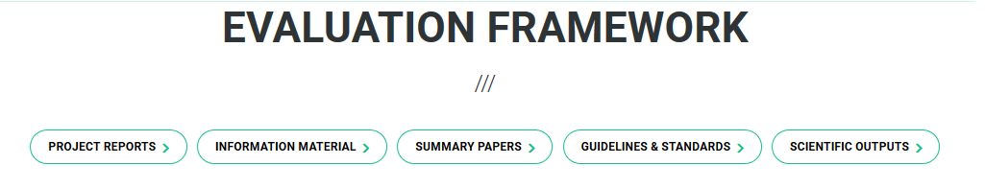

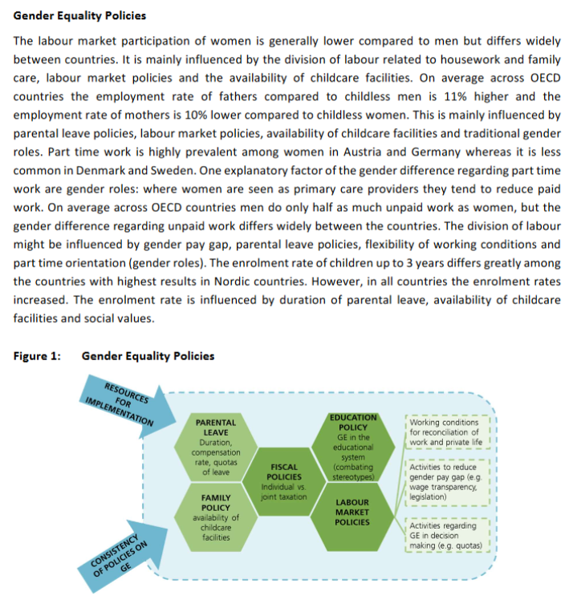
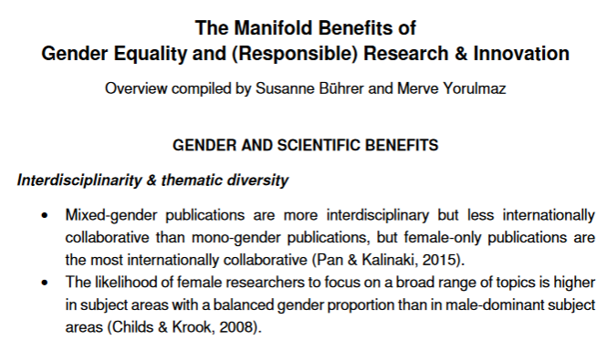
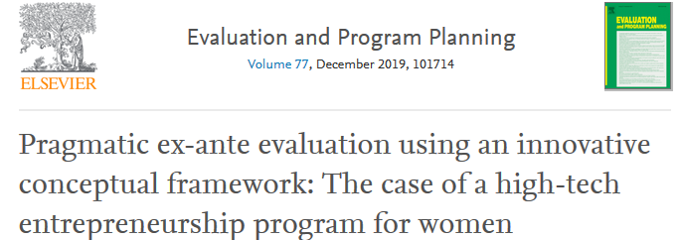
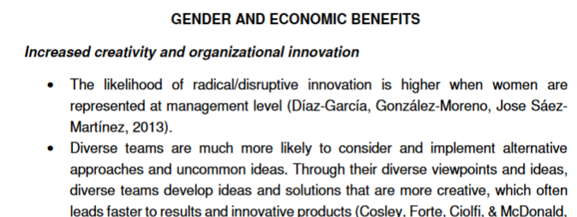
HOW
Notes:
RISK OF WRONG DIVERSIFICATION – NUMBER‘S GAME
DIFFERENTIATED AND PRUDENT HANDLING – AWARENESS OF CONTEXT DYNAMICS
CHALLENGES FOR RERUITING: NO UNIVERSAL STRATEGY

Slide 13
HOW
Impact Story
Knowledge Base
Shows impact pathways
Inspiration
Programme Theory Generator
Create and visualize own program theory with EFFORTI template
Creation
Evaluation
framework
Document & report database
Reading & literature
Notes:
RISK OF WRONG DIVERSIFICATION – NUMBER‘S GAME
DIFFERENTIATED AND PRUDENT HANDLING – AWARENESS OF CONTEXT DYNAMICS
CHALLENGES FOR RERUITING: NO UNIVERSAL STRATEGY

Slide 14
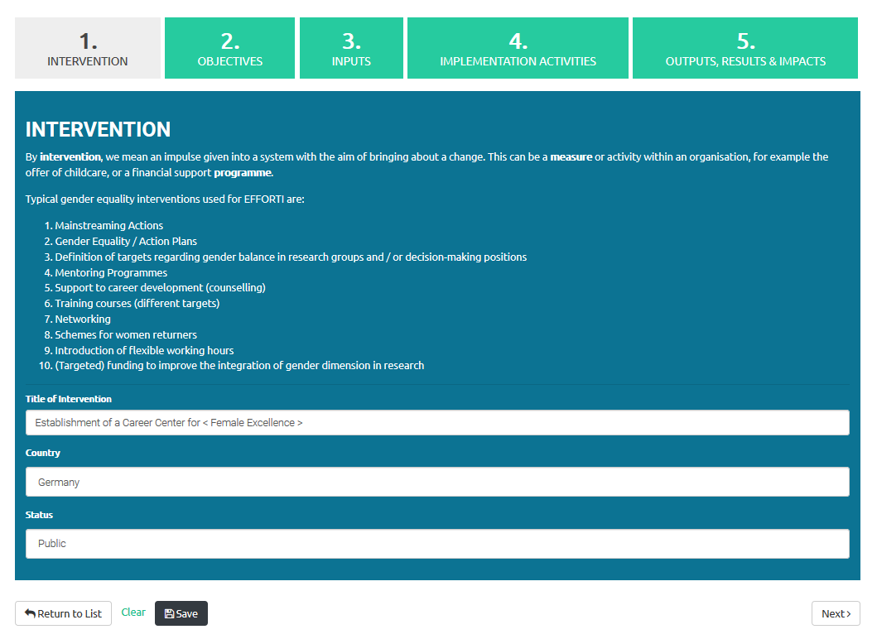

Slide 15
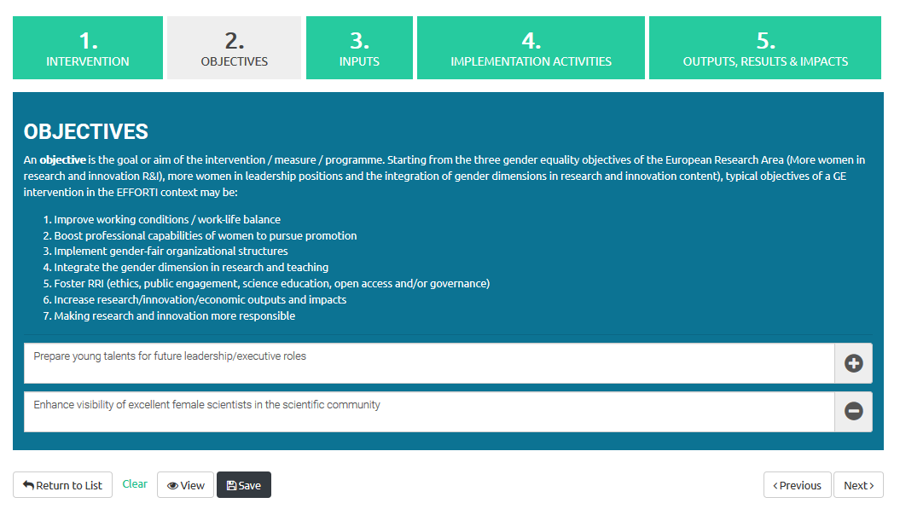

Slide 16
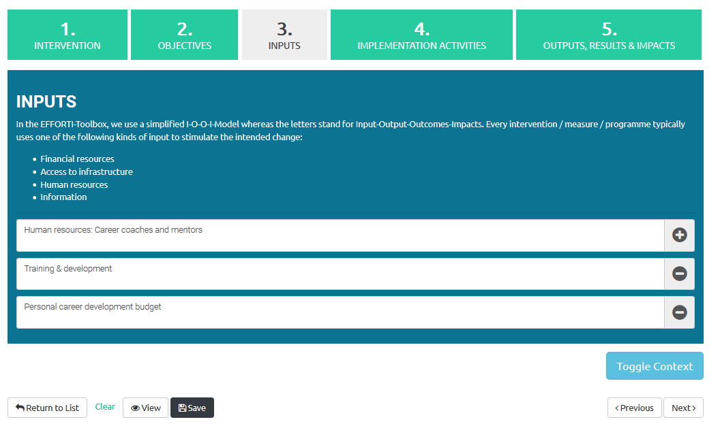

Slide 17
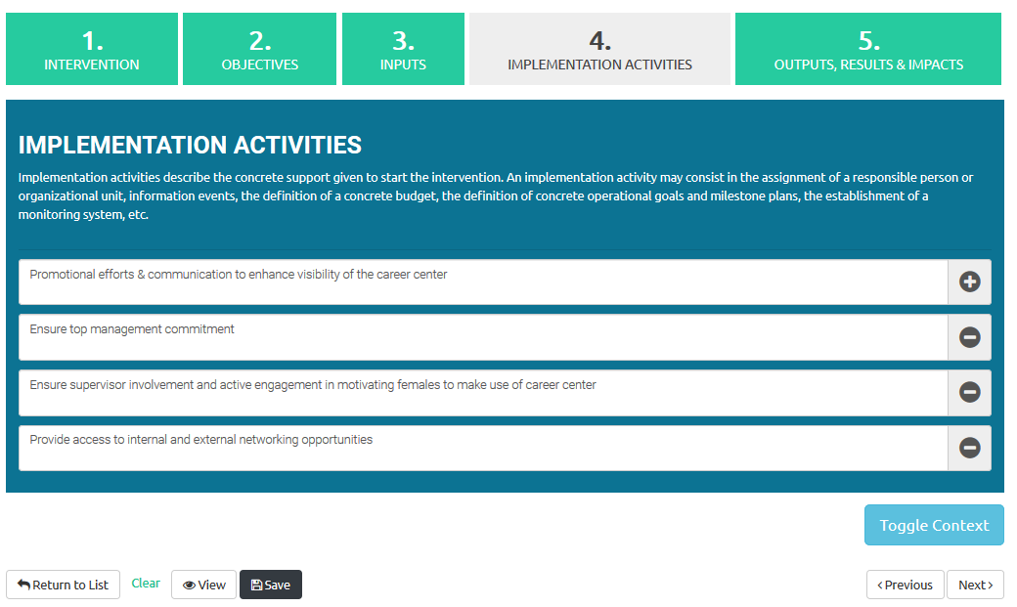

Slide 18
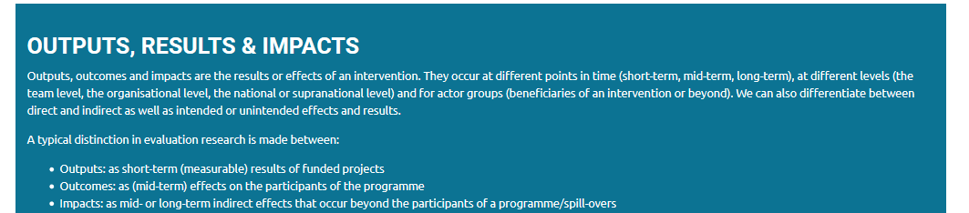

Slide 19
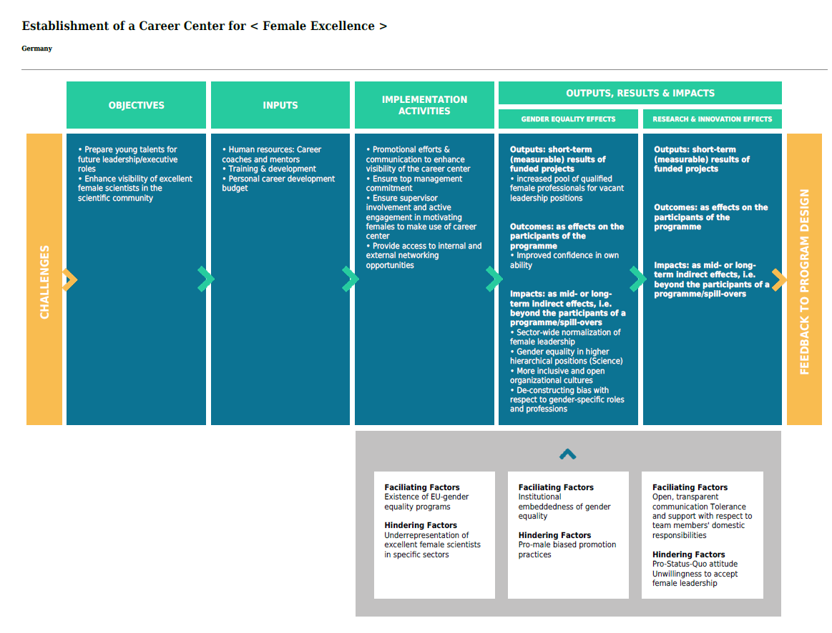
Policy Context
Organisational Context
Team Context
<

Slide 20





Example for the introduction of a Mentoring Programme
EFFICIENCY
OBJECTIVES
INPUTS
INITIATIVES TO PROMOTE GE
Activities
IMPLEMENTATION
OUTPUTS, RESULTS & IMPACTS
Gender Equality (GE) EFFECTS
Research and Innovation (R&I) EFFECTS
Other examples
Flextime
Funding
Networking
Career Support
Chairs and Positions
reserved for women
...
...
CHALLENGES
Enhance the (female) talent pool for career progression
Strengthening mentees’ professional and / or leadership skills
Increase the number of women in R&I positions
Recruitment process of mentors and mentees
Matching of well-suited mentor-mentee pairs
Launch meeting or workshop
Financial support for meetings between mentor and mentees
Outputs
Improved mentee confidence and satisfaction in research contexts s
Outcomes
Better visibility and achievement of women
Impact
Organisational changes by ensuring equal chances
Outcome
New research and innovation topics
Impact
Excellence and research and innovation quality
Increased corporate social responsibility
FEEDBACK TO PROGRAMM DESIGN
POLICY CONTEXT
ORGANISATIONAL CONTEXT
TEAM CONTEXT
Societies that still rely on traditional gender roles
Underrepresentation of women in
institutional environments and positions with high symbolic power
Male-dominated working environments that recognise women’s expertise less than men's
Existing "old boys’ clubs"
Lack of understanding for the importance and benefits of gender-specific approaches
Need for gender-aware competent researchers to initiate and implement activities
EFFECTIVENESS

Slide 21
AND NOW?
“I have created a comprehensive intervention plan that is specific to our company situation.
What should I do next? How does it help me?“
DIVERSITY & INCLUSION
STRATEGY & CHANGE
Monitoring. Planning. Controlling.
Strategic decision-making
Orientation. Reference. Benchmark.
Justification. Legitimization. Negotiation.
Recognition. Mainstreaming.
Source of future competitive advantage
Notes:
RISK OF WRONG DIVERSIFICATION – NUMBER‘S GAME
DIFFERENTIATED AND PRUDENT HANDLING – AWARENESS OF CONTEXT DYNAMICS
CHALLENGES FOR RERUITING: NO UNIVERSAL STRATEGY

Slide 22
Vielen Dank für Ihre Aufmerksamkeit!
Dr. Susanne Bührer
Competence Center Policy and Society
Fraunhofer Institute for Systems and Innovation Research ISI Breslauer Strasse 48, 76139 Karlsruhe
Tel. : 0049 / 721 6809 – 148
susanne.buehrer@isi.fraunhofer.de
Merve Yorulmaz
Competence Center Policy and Society
Fraunhofer Institute for Systems and Innovation Research ISI Breslauer Strasse 48, 76139 Karlsruhe
Tel. : 0049 / 721 6809 – 348
merve.yorulmaz@isi.fraunhofer.de

